Slide 1
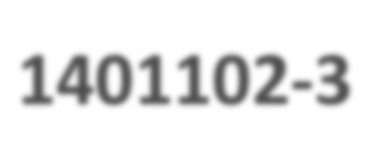

+
1401102-­‐3
Computer Programming
Fall 2021
Lecturer: Dr. Hatim Alsuwat
All Lecture notes represent a slightly edited version from lecture notes written by Dr. Abdulbaset Gaddah and Malak Aljabri

Slide 2
+
Outline
2
Why Java?!
Java features.
Typical Java Development Environment
Types of Java Applications
Java Program Structure
Good Programming Practice
Modifying Your First Java Program
Data Types & Variables

Slide 3
+
Why Java?
3
Java is a general-purpose programming language with a number of features that make the language well suited for many organizations‘ enterprise programming needs.
become the language of choice for implementing Internet-based applications and software for devices that communicate over a Network.
Java is a consolidation language, designed to absorb the strengths of earlier languages and ignore their weakness

Slide 4
+
Its features
4
Developed in 1990 by James Gosling at Sun Microsystem, and became freely available in 1995.
Developers around the world quickly adopted Java because of its features:
Simple
Object-Oriented
Distributed
Platform-Independent (portable)
Robust and Secure
Architecture-Neutral
Multithreaded
High-performance

Slide 5
+
Its features
5
Developed in 1990 by James Gosling at Sun Microsystem, and became freely available in 1995.
Developers around the world quickly adopted Java because of its features:
Simple
Object-Oriented
Distributed
Interpreted
Platform-Independent(portable)
Robust and Secure
Architecture-Neutral
Multithreaded
High-performance
borrows C++ syntax but greatly simplified and improved.
Java has a small set of language constructs.
Java uses automatic garbage collection.
Java is free from pointers.
No GoTo Statement

Slide 6
+
Its features
6
Developed in 1990 by James Gosling at Sun Microsystem, and became freely available in 1995.
Developers around the world quickly adopted Java because of its features:
Simple
Object-Oriented
Distributed
Interpreted
Platform-Independent(portable)
Robust and Secure
Architecture-Neutral
Multithreaded
High-performance
inherently OO language.
OOP is a popular programming approach that is replacing traditional procedural programming.
OOP offers great flexibility,
modularity, clarity, and reusability through encapsulation, inheritance, and polymorphism.

Slide 7
+
Its features
7
Developed in 1990 by James Gosling at Sun Microsystem, and became freely available in 1995.
Developers around the world quickly adopted Java because of its features:
Simple
Object-Oriented
Distributed
Interpreted
Platform-Independent(portable)
Robust and Secure
Architecture-Neutral
Multithreaded
High-performance
Distributed computing involves several computers
working together on a network.
Java is designed to provide support for extensive networking facilities (e.g., RMI)

Slide 8
+
Its features
8
Developed in 1990 by James Gosling at Sun Microsystem, and became freely available in 1995.
Developers around the world quickly adopted Java because of its features:
Simple
Object-Oriented
Distributed
Interpreted
Platform-Independent(portable)
Robust and Secure
Architecture-Neutral
Multithreaded
High-performance
The Java interpreter executes the bytecode that is generated by the Java compiler.
The bytecode is machine-independent and can run on any machine that has a Java Virtual Machine (JVM).

Slide 9
+
Its features
9
Developed in 1990 by James Gosling at Sun Microsystem, and became freely available in 1995.
Developers around the world quickly adopted Java because of its features:
Simple
Object-Oriented
Distributed
Interpreted
Platform-Independent(portable)
Robust and Secure
Architecture-Neutral
Multithreaded
High-performance
Because Java is architecture neutral, Java programs are portable.
bytecodes can be run JVM on multiple platforms over different operating systems without being recompiled.
Write Once and Run Anywhere(WORA).

Slide 10
+
Its features
10
Developed in 1990 by James Gosling at Sun Microsystem, and became freely available in 1995.
Developers around the world quickly adopted Java because of its features:
Simple
Object-Oriented
Distributed
Interpreted
Platform-Independent(portable)
Robust and Secure
Architecture-Neutral
Multithreaded
High-performance
strong memory management (no-pointers).
automatic garbage collection
runtime exception-handling
type checking mechanism

Slide 11
+
Its features
11
Developed in 1990 by James Gosling at Sun Microsystem, and became freely available in 1995.
Developers around the world quickly adopted Java because of its features:
Simple
Object-Oriented
Distributed
Interpreted
Platform-Independent(portable)
Robust and Secure
Architecture-Neutral
Multithreaded
High-performance
no implementation dependent features e.g. size of primitive types is fixed.

Slide 12
+
Its features
12
Developed in 1990 by James Gosling at Sun Microsystem, and became freely available in 1995.
Developers around the world quickly adopted Java because of its features:
Simple
Object-Oriented
Distributed
Interpreted
Platform-Independent(portable)
Robust and Secure
Architecture-Neutral
Multithreaded
High-performance
Multithreaded programming is smoothly integrated in Java, whereas in other languages you have to call procedures specific to the operating system to enable multithreading.
It allows more than one task in a program to be executed at the same time and hence increase the system performance.

Slide 13
+
Its features
13
Developed in 1990 by James Gosling at Sun Microsystem, and became freely available in 1995.
Developers around the world quickly adopted Java because of its features:
Simple
Object-Oriented
Distributed
Interpreted
Platform-Independent(portable)
Robust and Secure
Architecture-Neutral
Multithreaded
High-performance
The new JVM uses the technology known as just-in-time (JIT) compilation.
With JIT complier the interpreted code gives almost the native code speed.

Slide 14
+
Typical Java Development Environment
Java programs normally go through five phases
Editing or Creating Java program
Compiling Java Program
Loading the program into the memory
Bytecode Verification
Execution
14

Slide 15
+
Typical Java Development Environment
Java programs normally go through five phases
15
Phase 1
Editor
Disk
Program is created in an editor and stored on disk in a file ending with .java.
Phase 2
Compiler
Disk
Compiler creates bytecodes and stores them on disk in a file ending with .class.
Primary Memory
Phase 3
Class Loader
Class loader reads .class
files containing bytecodes from disk and puts those bytecodes in memory.
Disk
. .
. .
.
.
Bytecode Verifier
Primary Memory
Phase 4
Bytecode verifier confirms that all bytecodes are valid
and do not violate Java’s security restrictions.
. .
. .
.
.
Primary Memory
Phase 5
Interpreter
Interpreter reads bytecodes and translates them into a language that the computer can understand, possibly storing data values as the program executes.
. .
. .
.
.

Slide 16
+ Typical Java Development Environment
(Phase 1)
16
 Phase 1: Editing a file with an editor
Type a Java program (source code) using the editor.
Make any necessary corrections.
Save the program.
A file name ending with the .java extension indicates that the file contains Java source code.
Example of editors include:
Linux editors: vi and emacs.
Notepad
Notepad++
Textpad
Etc.
Or using Integrated development environments (IDEs)

Slide 17
+ Integrated Development Environments
(IDEs)
17
IDE provide different tools including:
Editor for writing and editing programs
Some provides features like: syntax highlighting and code completion etc.
There are many java development tools that support the development of Java software, including:
NetBeans (we will be using this IDE in this course)
Eclipse
JDeveloper
JBuilder
JCreater
Visual Café
BlueJ
jGRASP
Though the details of these environments differ, the basic compilation and execution process is essentially the same.

Slide 18
+ Typical Java Development Environment
(Phase 2)
18
Phase 2: compiling a Java program
Use the command javac (Java compiler) to compile a program. For example, to compile a program called Welcome.java, you’d type javac Welcome.java
If the program compiles, the compiler produces a .class file called Welcome.class that contains the compiled version of the program
Java compiler translates Java source code into bytecodes that represent the tasks to execute.
Bytecodes are executed by the Java Virtual Machine (JVM): a part of the JDK and the foundation of the Java platform.
Virtual machine (VM): a software application that simulates a computer and hides the underlying operating system and hardware from the programs that interact with it.

Slide 19
+ Typical Java Development Environment
(Phase 2)
19
If the same VM is implemented on many computer platforms, applications that it executes can be used on all those platforms.
Bytecodes are platform independent
They do not depend on a particular hardware platform
Bytecodes are portable
The same bytecodes can execute on any platform containing a JVM that understands the version of Java in which the bytecodes were compiled
JVM is invoked by the java command. For example, to execute a Java application called Welcome, you’d type the command java Welcome

Slide 20
+ Typical Java Development Environment
(Phase 3)
20
Phase 3: Loading a Program into Memory
The JVM places the program in memory to execute it—this is known as loading.
Class loader takes the .class files containing the program’s bytecodes and transfers them to primary memory.
Also loads any of the .class files provided by Java that your program uses.
The .class files can be loaded from a disk on your system or over a network.

Slide 21
+ Typical Java Development Environment
(Phase 4)
21
Phase 4: Bytecode Verification
As the classes are loaded, the bytecode verifier checks their bytecodes to ensures that they’re valid and don’t violate Java’s security restrictions
Java enforces strong security to make sure that Java programs arriving over the network do not damage your files or your system (as computer viruses and worms might)

Slide 22
+ Typical Java Development Environment
(Phase 5)
22
 Phase 5: Execution
The JVM executes the program’s bytecodes using a combination of interpretation and so-called just-in-time (JIT) compilation
A just-in-time (JIT) compiler—known as the Java HotSpot compiler—translates the bytecodes into the underlying computer’s machine language.
When the JVM encounters these compiled parts again, the faster machine language code executes
Java programs go through two compilation phases
One in which source code is translated into bytecodes (for portability across JVMs on different computer platforms) and
A second in which, during execution, the bytecodes are translated into machine language for the actual computer on which the program executes

Slide 23
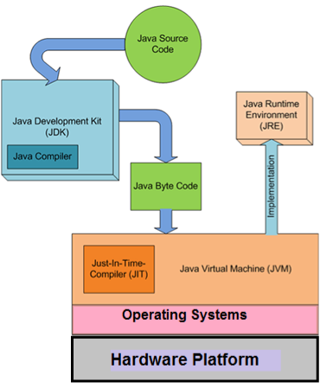
+
What is JDK, JRE, and JVM?
 Java Development Kit (JDK):
Contains tools needed to develop the Java programs. The tools include Java libraries, Java source compilers, Java debuggers, bundling and deployment tools. It also contain JRE to run the programs
 Java Runtime Environment (JRE):
Contains JVM with a JIT compiler, class libraries, and other supporting files. We need JRE to run any Java program
 Java Virtual Machine (JVM):
Provides a platform-independent way of executing Java bytecode. It is a keystone of the write-once run-anywhere value of Java programs
23

Slide 24
+
JDK Programming Tools
24
 appletviewer: run applets.
 javac (compiler): .java →→ .class.
 java (interpreter): executes .class.
 javadoc (document generator): .java →→ .html.
 javap (disassembler): .class →→ info.
 jdb (debugger): debug .class.

Slide 25



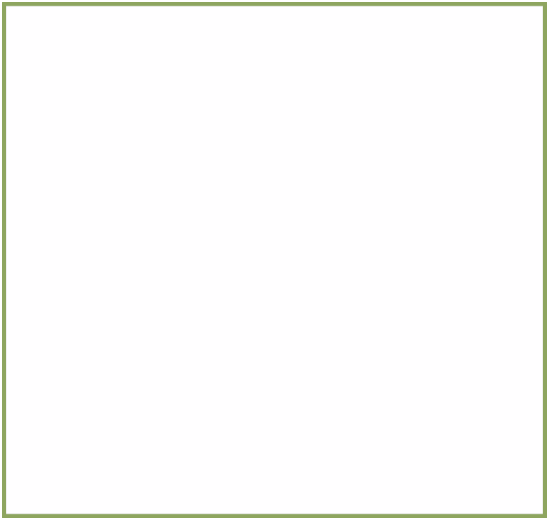
+
Types of Java Applications
25
Java Program
An Applet:
is an application designed to be transmitted over the internet and executed by the java compatible web browsers
Web-­‐based applications:
are programs that are loaded into a Web server to provide additional server functionality. Such applications are based on client-­‐server architecture and users can access them through Web browser
An application:
is a program that runs on your computer just like any other programs created with C or C++

Slide 26
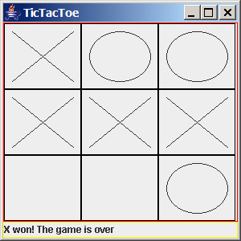
+
TicTacTOe Standalone Application
26

Slide 27
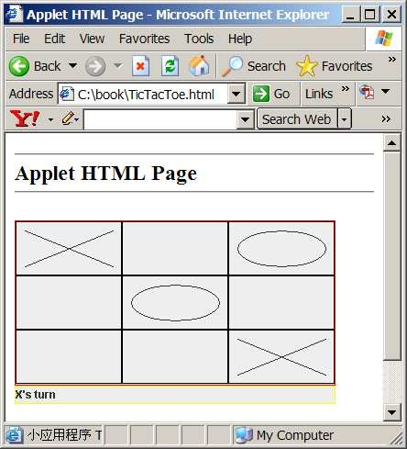
+
TicTacTOe Applet Application
27

Slide 28
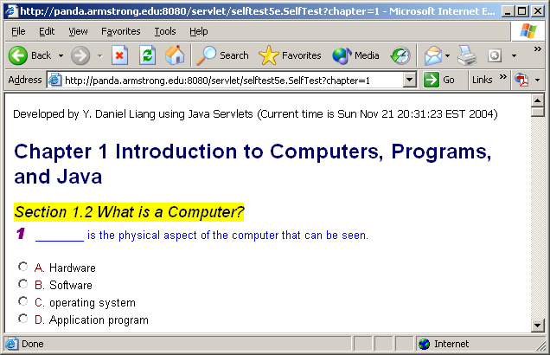
+
SelfTest Website (using Java Servlets)
28

Slide 29
+
Java Program Structure
Comments can be placed almost anywhere
// comments about the class
29
public class Hello
{
class header
Java Keywords
class name
class body
}
Everything that a program does is described between the first brace and the final brace of a class.

Slide 30
+
Java Program Structure
30
// comments public class
{
about Hello
the class
// comments
about
the main method
public static
void main ( String[]
args )
method body
{
Java keywords
method name
method header
here
// Program execution begins
System.out.println("Hello
World!");
}
}
main method — where the JVM starts running the program

Slide 31
+
Java Program Structure
 Class declaration
31
public class Hello
Every Java program consists of at least one class that you define
class keyword introduces a class declaration and is immediately followed by the class name
Java class declaration normally contain one or more methods.
Keywords are reserved for use by Java and are always spelled with all lowercase letters
 Class names
By convention, begin with a capital letter and capitalize
the first letter of each word they include (e.g., SampleClassName)
A class name is an identifier—a series of characters consisting of letters, digits, underscores (_) and dollar signs ($) that does not begin with a digit and does not contain spaces
Java is case sensitive—uppercase and lowercase letters are distinct

Slide 32
+
Java Program Structure
32
 Braces
A left brace, {, begins the body of every class declaration
A corresponding right brace, }, must end each class declaration
It is a syntax error if braces do not occur in the matching pairs
Declaring the main Method
public static void main( String[] args)
Starting point of every Java program
Parentheses after the identifier main indicate that it’s a program building block called a method
main must be defined as shown; otherwise, the JVM will not execute the program
Keyword void indicates that this method will not return any value
If the program has more than one class, the name of the class containing the main method must be used
The class containing the main method must be declared as public

Slide 33
+
Java Program Structure
33
Declaring the main Method
public static void main( String[] args)
Why is the main method declared static?!
The JVM attempts to invoke the main method of the class you specify – when no objects of the class have been created.
Declaring main as static allows the JVM to invoke main without creating an instance of the class

Slide 34

+
Java Program Structure
 Body of the method declaration
Enclosed in left and right braces { … }
34
 Statement
System.out.println("Hello World!");
statement
Object
Class Method
Instructs the computer to display a string of characters contained between the double quotation marks on the screen
White-space characters in strings are not ignored by the compiler
Most statements end with a semicolon ( ; )
The string in the parentheses the argument to the method
Positions the output cursor at the beginning of the next line on the
screen (command window)
Strings cannot span multiple lines of code
System.out.println("Hello
World!");

Slide 35
+
Java Program Structure
35
Whenever you use a method in Java, you must specify three items:
The object containing the method – System.out
The name of the method – Println
A pair of parenthesis which may contain any other information needed by the method e.g. (“Hello world!!”)

Slide 36
+
Tracing the Program
Enter main method
36
prints
Hello
World!
//This program public class Hello {
public static void main(String[] args) {
System.out.println("Hello
World!");
}
}

Slide 37
+
Tracing the Program
Execute Statement
37
//This public
program
prints Hello World!
class
Hello {
public
static
void main(String[]
args) {
System.out.println("Hello World!");
}
}

Slide 38
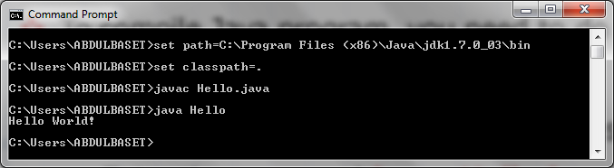
+
38
//This public
program
prints Hello World!
class
Hello {
public
static
void main(String[]
args) {
System.out.println("Hello World!");
}
}
print a message to the console

Slide 39
+
Analysis of a Java Program
39
 Comments
 Reserved words
 Modifiers
 Identifiers
 Statements
 Blocks
 Classes
 Methods
 The main method

Slide 40
+
Java Comments
40
 Java comments can take three forms:
Line comment: is preceded by two slashes (//) in a line
// this comment runs to the end of the line
Paragraph comment: is enclosed between /* and */ in one or multiple lines
/* this comment runs to the terminating
symbol, even across line breaks */
javadoc comment: begins with /** and end with */. They are used for documenting classes, data, and methods.
They can be extracted into an HTML file using JDK's javadoc command
/** this is a javadoc comment */
Comments should be included to explain the purpose of the program and describe processing steps
They do not affect how a program works (compiler ignores comments)

Slide 41
+
Reserved Words
Reserved words or keywords are words that have a specific meaning to the compiler and cannot be used for other purposes in the program. For example, when the compiler sees the word class, it understands that the word after class is the name for the class
We must use reserved words only for their intended purpose.
For example, we can't use the word class for any other purpose than defining a class
41

Slide 42
+
Reserved Words
 The Java reserved words:
42
abstract | else | interface | switch
assert | enum | long | synchronized
boolean | extends | native | this
break | false | new | throw
byte | final | null | throws
case | finally | package | transient
catch | float | private | true
char | for | protected | try
class | goto | public | void
const | if | return | volatile
continue default | implements import | short static | while
do | instanceof | strictfp
double | int | super

Slide 43
+
Modifiers
Java uses certain reserved words called modifiers that specify the properties of the data, methods, and classes and how they can be used
Examples of modifiers are public and static. Other modifiers are private, final, abstract, and protected. A public datum, method, or class can be accessed by other programs. A private datum or method cannot be accessed by other programs
43

Slide 44
+
Identifiers
44
Identifiers are the words a programmer uses in a program
An identifier consists of alphabetical characters and digits (plus the underscore '_' and the dollar sign '$' characters.
Identifiers can start with a character, '_' or '$' but cannot start with a digit. Digits can be used after the first character (e.g., x1)
No spaces are allowed inside the identifier's name
Java is case sensitive - Total, total, and TOTAL are different identifiers
Cannot be keywords or reserved words
An identifier can be of any length

Slide 45
+
Java Statements
Is a command for the computer to do something. Any statement in Java should be followed by a semicolon ( ; )
Methods are built out of statements.
The statements in a method are placed between braces { and } as in this example
45
public class Hello {
public static void main ( String[] args )
{
System.out.println("Hello World!");
}
}
There are several types of statements in Java. For example, declaration, assignment, control, and loop statements.

Slide 46
+
Blocks
A pair of curly braces in a program forms a block that groups components of a program
Examples:
o Class block, method block, statement block, ...
46
public class Hello
{
public static void main (String[] args)
Class block
{
System.out.println("Hello World!");
Method block
}
}

Slide 47
+
Classes
The class is the essential Java construct. It is a template or a blueprint for objects. To program in Java, you need to understand classes and be able to write and use them. The mystery of the class will continue to be unveiled throughout this course. For now, though, understand that a program is defined by using one or more classes
47
public class
{
………..
Hello
………..
}

Slide 48
+
Methods
48
What is System.out.println("Hello World!")?
It is a method – a collection of statements that performs a sequence of operations to display a message on the console. It can be used even without fully understanding the details of how it works. It takes a single argument. This argument is enclosed within parentheses. In this case, the argument is of type string "Hello World!"
You can call the same println method with a different argument to print a different message

Slide 49
+
Main Method
The main method provides the control of program flow
The Java interpreter executes the application by invoking the main method
The main method looks like this:
49
public static
{
void main ( String[] args )
Statement(s);
}

Slide 50
+
Types of Programming Errors
50
 Syntax (compile-time) error: A grammatical mistake in a program
The compiler can detect these errors, and will output a message saying what it thinks the error is, and where it thinks the error is
Here is the sample program with a deliberate error:
public Class Hello {
public static void main ( String[] args ) {
System.out.println("Hello World!");
public Class Hello {
public static void main ( String[] args ) { System.out.println("Hello World!");
}
}
The reserved word "class" has been changed to "Class" with a capital "C". Here is what happens when the program is compiled:
C:\Temp>javac Hello.java compiling: Hello.java
Hello.java:1: Class or interface declaration expected. Class Hello
^
1 error

Slide 51
+
Types of Programming Errors
51
 Logic error: A mistake in the underlying algorithm for a program
The compiler cannot detect these errors, and no error message is generated after compilation or during execution, but the program does not do what it is supposed to do
Just because a program compiles and runs does not mean that it is correct. For example, say that your assignment is to create a program that writes "Hello World!" on the computer monitor. But you write the following program.
public class Hello {
public static void main ( String[] args ) { System.out.println( "Hello
Abdulbaset!" );
}
}
public class Hello {
public static void main ( String[] args ) { System.out.println( "Hello Abdulbaset!" );
}
}

Slide 52
+
Basic Program Development
52
Edit and save program
errors Compile program |  | errors
 | Execute program and evaluate results

Slide 53
+
Good Programming Practice
 Appropriate Comments:
Starts your program with a comment that states the purpose of the program, the author, time and date of the last program modifications
Write a comment before each class, documenting the purpose of the class
Write a comment before each method, documenting the purpose of the method
Write an end of line (single line) comment, documenting the purpose of the statement
53

Slide 54
+
Good Programming Practice (Cont’d)
 Naming Conventions:
o Choose meaningful and descriptive names helps a program to be self-documenting. Easy to understand
Which code is easier to understand?
Code Sample 1:
54
float float float
gradeOfExam1 = 90.0;
gradeOfExam2 = 95.0; averageGrades = (gradeOfExam1
+ gradeOfExam2)/2;
Code sample 2:
float float float
asdfghjk = 90.0;
rujflwe = 95.0;
dfiefjek = (asdfghjk + rujflwe)/2;

Slide 55
+
Good Programming Practice (Cont’d)
 Variable and method Naming:
Use lowercase. If the name consists of several words, concatenate all in one, use lowercase for the first word, and capitalize the first letter of each subsequent word in the name. For example, the variable age or myAge, and the method result() or myResult()
 Class Naming:
Capitalize the first letter of each word in the name.
For example, the class name School or MySchool
 Constant Naming:
Capitalize all letters in constants, and use underscores to connect words. For example, the constant PI and MAX_VALUE
55

Slide 56
+
Good Programming Practice (Cont’d)
 Proper Indentation and Spacing:
Use blank lines to separate segments of the code
Use space characters and code indentations to enhance program readability
Write each statement in a separate line , allowing end of line comment. For example:
System.out.println("Hello World!"); // print a string
In the next slide, which code do you think it is more readable?
56

Slide 57
+
Good Programming Practice (Cont’d)
57
Code Sample 1:
public class Test1 {
public static void main ( String[] args ) { System.out.println("On a withered branch");
System.out.println("A crow has just alighted:"); System.out.println("Nightfall in autumn.");
}
}
Code sample 2:
public
class
Test1{ public
{
static
void main(String[] args )
System.out.
println( out.println("A
"On a withered branch"); crow has just alighted:"
in autumn.");
System .
);
System.out.println("Nightfall
}}

Slide 58
+
Good Programming Practice (Cont’d)
 Block Styles:
You may use next-line or end-of-line style for braces
You should stick with one style in the whole code
58
Next-line style
public class Test
{
public static void main(String[] args)
{
System.out.println("Block Styles");
}
}
End-of-line style
public class Test {
public static void main(String[] args) { System.out.println("Block Styles");
}
}

Slide 59
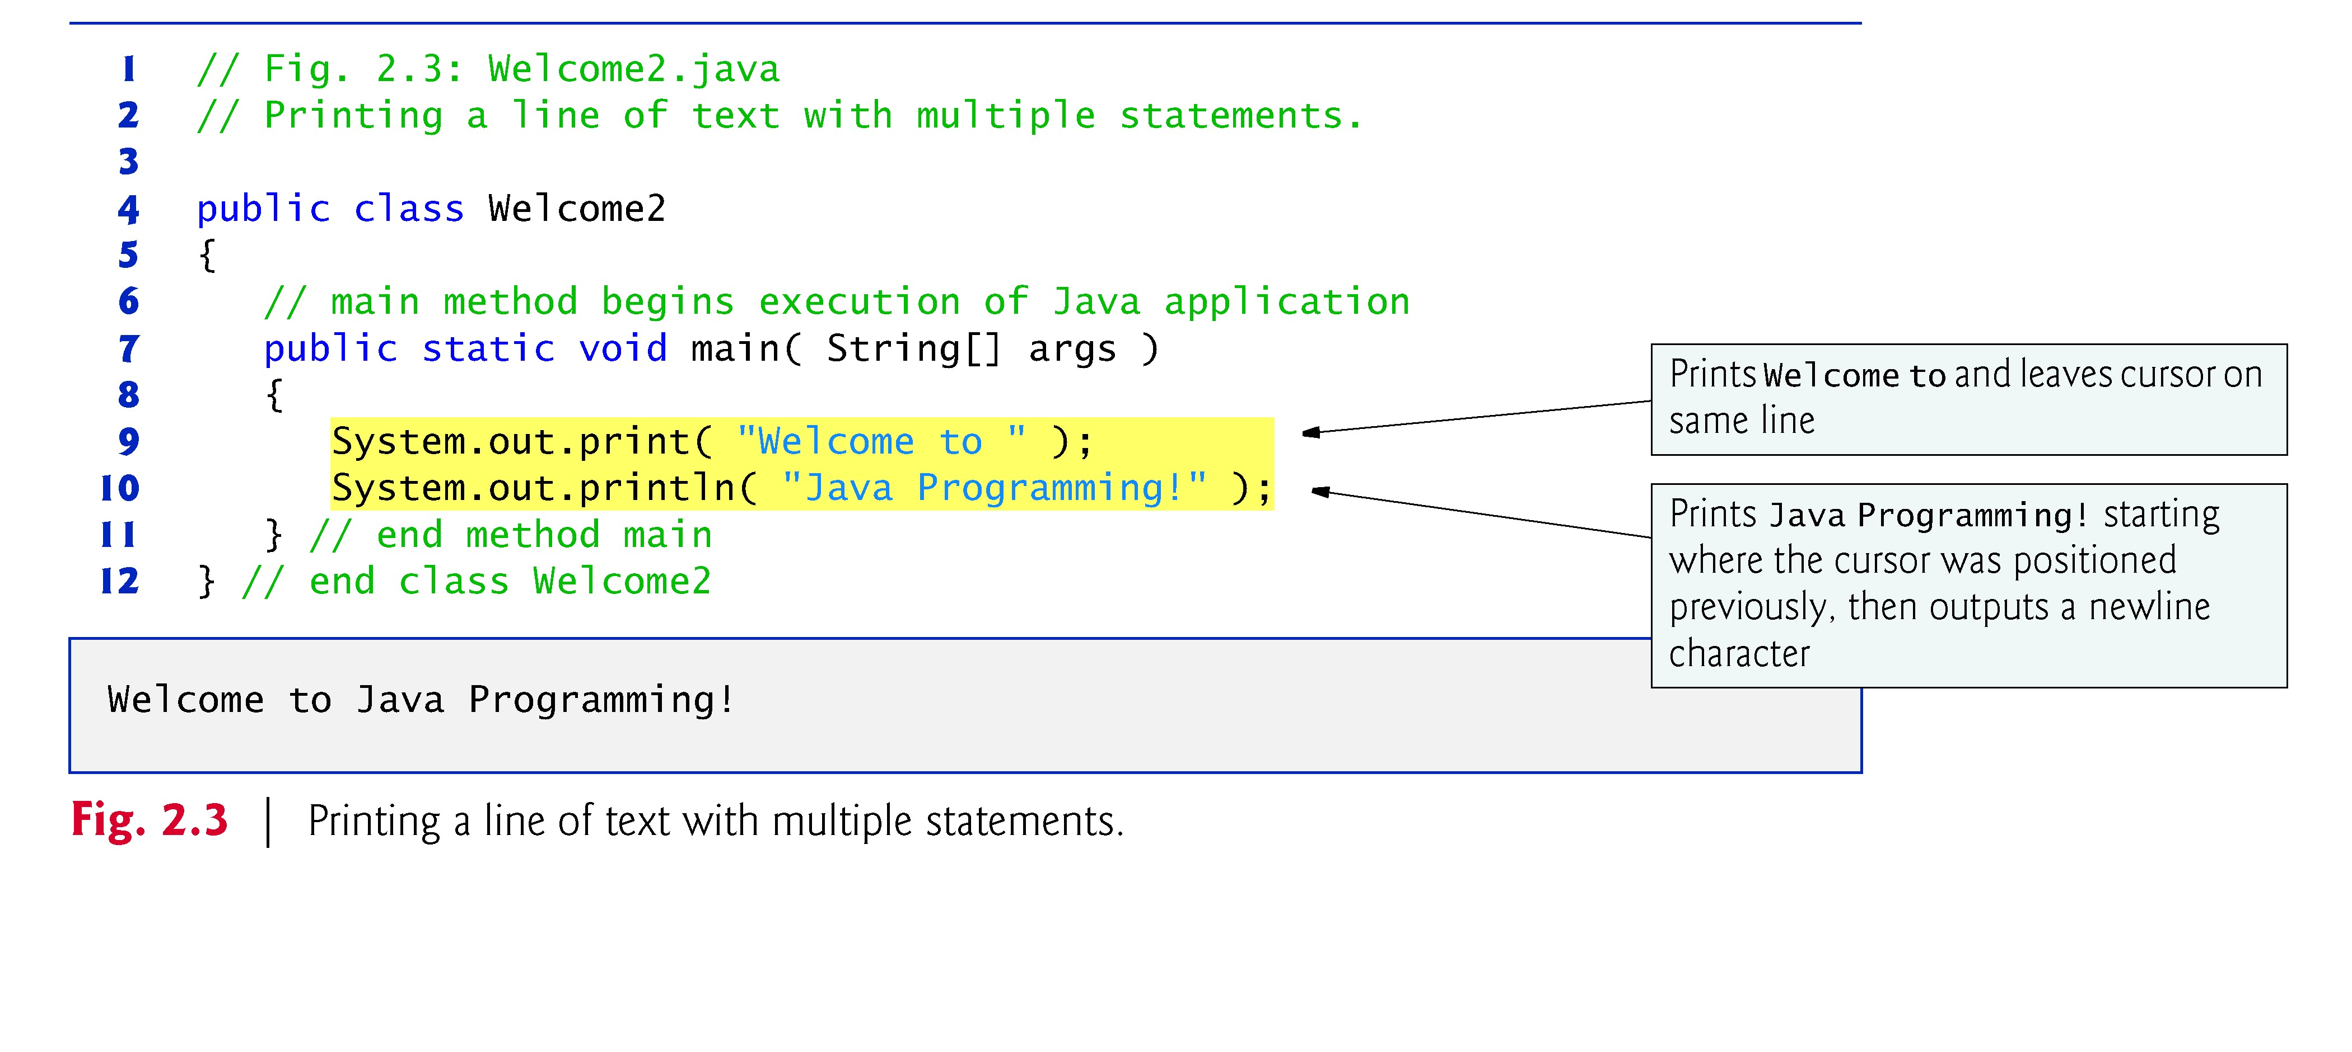
+
Modifying Your First Java Program
59

Slide 60
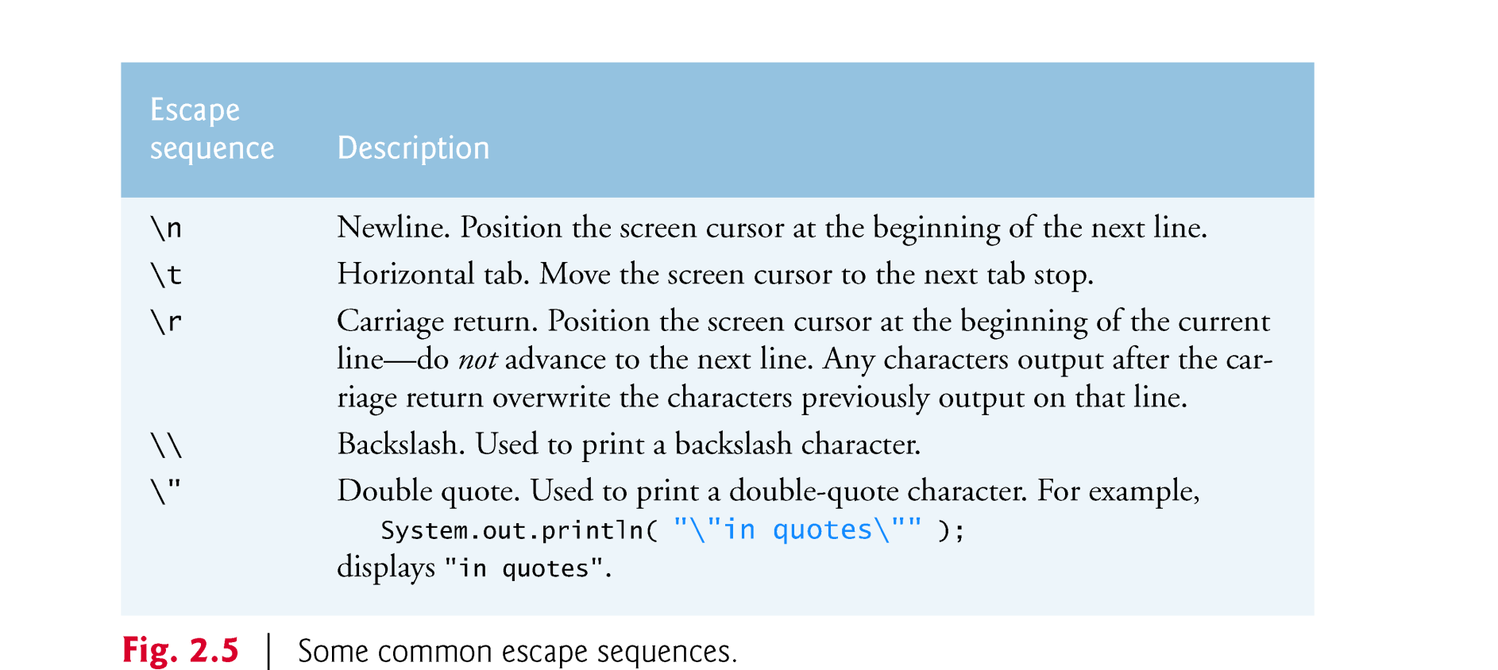
+
Modifying Your First Java Program
60
Newline characters indicate to System.out’s print and println methods when to position the output cursor at the beginning of the next line in the command window.
The backslash (\) is called an escape character “special character”
Backslash is combined with the next character to form an escape sequence.

Slide 61
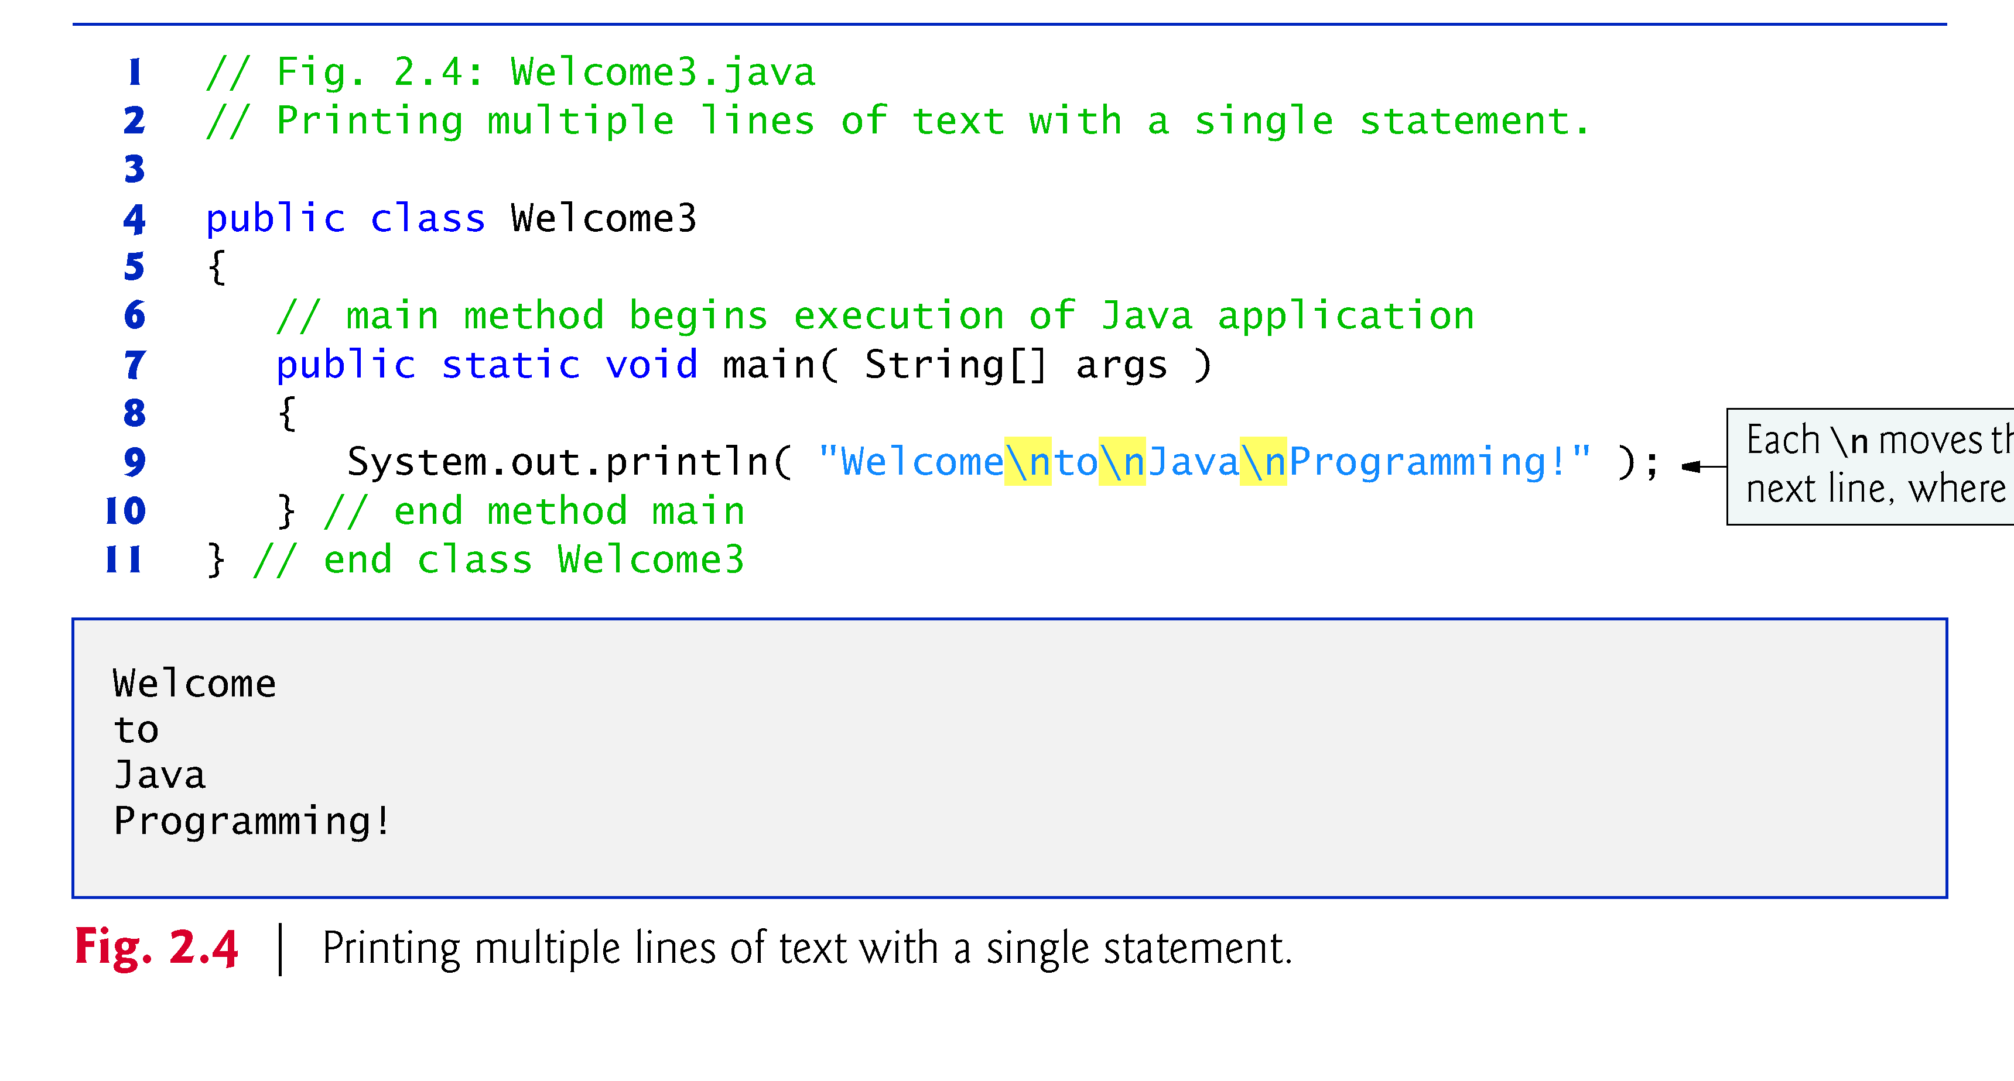
+
Modifying Your First Java Program
61

Slide 62
+
Data Types
62
Are the kinds of values that can be stored and manipulated within computer programs
Tell the OS how much memory to allocate, what can be stored in the reserved memory, and what types of operations are allowed
Also enable the Java compiler to check for type compatibility among the expressions and variables.
Java is a strongly typed programming language
Every variable must be declared with a data type
Once it is declared, the data type of the variable cannot change
There are two main data types available in Java:
Primitive date types (the basic, fixed-size types)
Reference date types (the composite types)

Slide 63
+
Primitive Data Types
63
Are predefined (built-into the language) types that represent a range of values.
They are named by reserved keywords in Java
There are eight primitive data types in Java
Four of them represent integer numbers:
byte, short, int, long
Two of them represent floating point numbers:
float, double
Numeric Data Types
One of them represents characters: char
And one of them represents boolean values:
boolean
Dr. Abdulbaset Gaddah & I. Omniah Nagoor

Slide 64
Primitive Data Types
+
64
Type Kind of Value Default Size Range
Wrapper
 |  |  |  |  | Class
boolean | true or false | false | 1 bit | NA | Boolean
char | Unicode character | \u0000 | 16 bits | \u0000 to \uFFFF | Character
byte | Signed integer | 0 | 8 bits | -128 to 127 | Byte
short | Signed integer | 0 | 16 bits | -32768 to 32767 | Short
int | Signed integer | 0 | _{32 bits} -2147483648 to _{Integer} 2147483647
long | Signed integer | 0 | _{64 bits} -9223372036854775808 to _{Long} 9223372036854775807
float | floating point | 0.0 | 32 bits ^{±1.4E-45 to} Float ±3.4028235E+38
double | floating point | 0.0 | 64 bits ^{±4.9E-324 to} Double
Dr. Abdulba
set Gaddah & I. Omniah Nagoor
±1.7976931348623157E+308

Slide 65
+
Variable Declaration
65
 Variable – a location in main memory that holds one value of a particular data type at a time, but that value can change
Must be declared with a name and a type before they can be used
A variable’s name enables the program to access the value of the variable in memory. It can be any valid identifier
A variable’s type specifies what type of information is stored at that location in memory . It can be one of the primitive data types
Once a variable is declared, its data type cannot change
The type of the variable is followed by one or more variable names separated by commas (,) and terminated with a semicolon (;)
Syntax: Data_Type Variable_Name;
Examples: double radius;
double area;
OR
double radius, area;

Slide 66
+
Assignment Statements
66
In Java, the assignment statement is used to change the value of a variable
The equal sign (=) is used as the assignment operator
An assignment statement consists of a variable on the left side of the (=) operator, and an expression on the right side of the (=) operator
Syntax: Variable_Name = Expression;
Example: area = radius * radius * PI;
An expression may consist of a variable, number, or mix of variables, numbers, operators, and/or method invocations
Other Examples:
radius = 20;
radius = newRadius;
radius = 1.2 * getCurrentRadius();

Slide 67
+
Assignment Statements (Cont’d)
When an assignment statement is executed, the expression is first evaluated, and then the variable on the left-hand side of the equal sign is set equal to the value of the expression
area = radius * radius * PI;
The compiler always checks the type compatibility of the used variables and expressions
The same variable can occur on both sides of the assignment operator count = count + 1;
The assignment operator is automatically executed from right-to- left, so assignment statements can be chained
var3 = var2 = var1 = 3;
67

Slide 68
+
Variable Initialization
68
A variable that has been declared but that has not yet been given a value by some means is said to be uninitialized
In certain cases, the Java compiler gives a default value to an uninitialized variable based on its data type (see slide #53)
It is best not to rely on this
Explicitly initialized variables improves program clarity
In some cases, variables must be given initial values
E.g., if we try to use a variable without first giving it an initial value:
int numberOfDays;
numberOfDays = numberOfDays + 10;
The Java compiler will throw an error:
variable numberOfDays might not have been initialized

Slide 69
+
Variable Initialization (Cont’d)
69
 Variable declaration and initialization can be achieved in one step via an assignment statement
int number = long max = x | 223; + 1; |  | boolean b = true; double distance =
55 * 0.5;
char grade = | 'A'; | OR | char grade =
'\u0041';
Note that some variables can be initialized and others can remain uninitialized in the same declaration
int initialCount = 5, finalCount, anotherCount = 10;
OR
int initialCount = 5, finalCount,
anotherCount = 10;
int x1 = 0, int x2, double x3 = 1.0; // error

Slide 70
+
Reference Book
70
Java How to Program, 9/e

Slide 71

+
Any Questions??
71

